Slide 1
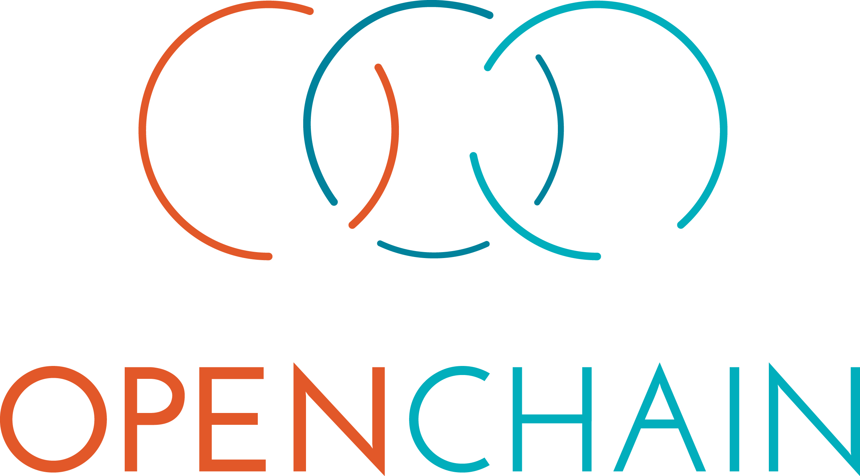
How do I trust my open source supply chain?
Notes:
The OpenChain Project is here to help improve compliance processes and build trust across the supply chain.

Slide 2






Open Compliance Program Solutions
Processes
Bill of Materials
SPS
Tooling
SPDX Tools
https://compliance.linuxfoundation.org/
Notes:
Compliance is core to effective strategic engagement with open source technology. It is very important that we can contextualize this effectively for our supply chains. There are various pre-existing industry standards to help contextualize solutions in this space (OpenChain and SPDX) and there is extensive tooling to support automation.

Slide 3

OpenChain Platinum Member Companies
Notes:
Here are the current Platinum Member companies in the OpenChain Project.

Slide 4
The OpenChain Project defines the key requirements of a quality open source compliance program.
Notes:
The most important thing is that the OpenChain Specification defines the requirements for a quality compliance program.

Slide 5
OpenChain Defines Inflection Points
upstream
downstream
inbound
Training
Policy
outbound
Process
Notes:
It defines the big picture, showing the inflection points where a company should have processes, policies or training.

Slide 6
Result: Predictable B2B Compliance Activity
Notes:
Taken in aggregate the adoption of OpenChain by companies in a supply chain dramatically reduces the chance of errors in individual companies, dramatically increases the predictability of how other companies in the supply chain address compliance, and dramatically reduces the time to isolate and remediate process errors or failings. Everyone is asking and answering the same questions.

Slide 7
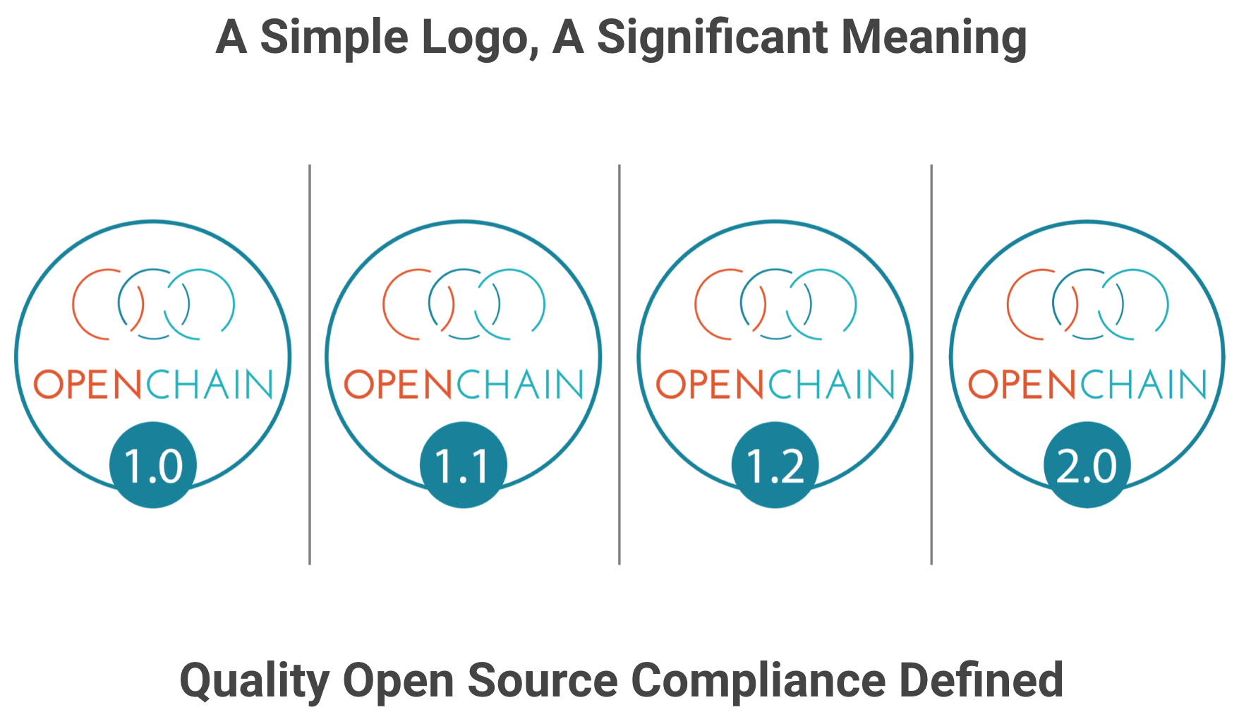
Notes:
Companies that meet the OpenChain Specification requirements can use a badge to identify their OpenChain Conformant program and the products that went through this program.

Slide 8

Example Conformant Organizations
Notes:
There are a number of companies with a publicly announced OpenChain Conformant program. These companies come from a wide range of industries and represent a wide range of company sizes. Of course, there are many more undergoing OpenChain Conformance or without a publicly announced program.

Slide 9
Work Groups + Lists + GitHub
Main List (3,700+ participants)
GitHub (105+ participants)
Automotive (115+ participants)
Reference Tooling (160+ participants)
China (105+ participants)
Japan (190+ participants)
Korea (40+ participants)
Taiwan (40+ participants)
India (40+ participants)
Germany (30+ participants)

Slide 10
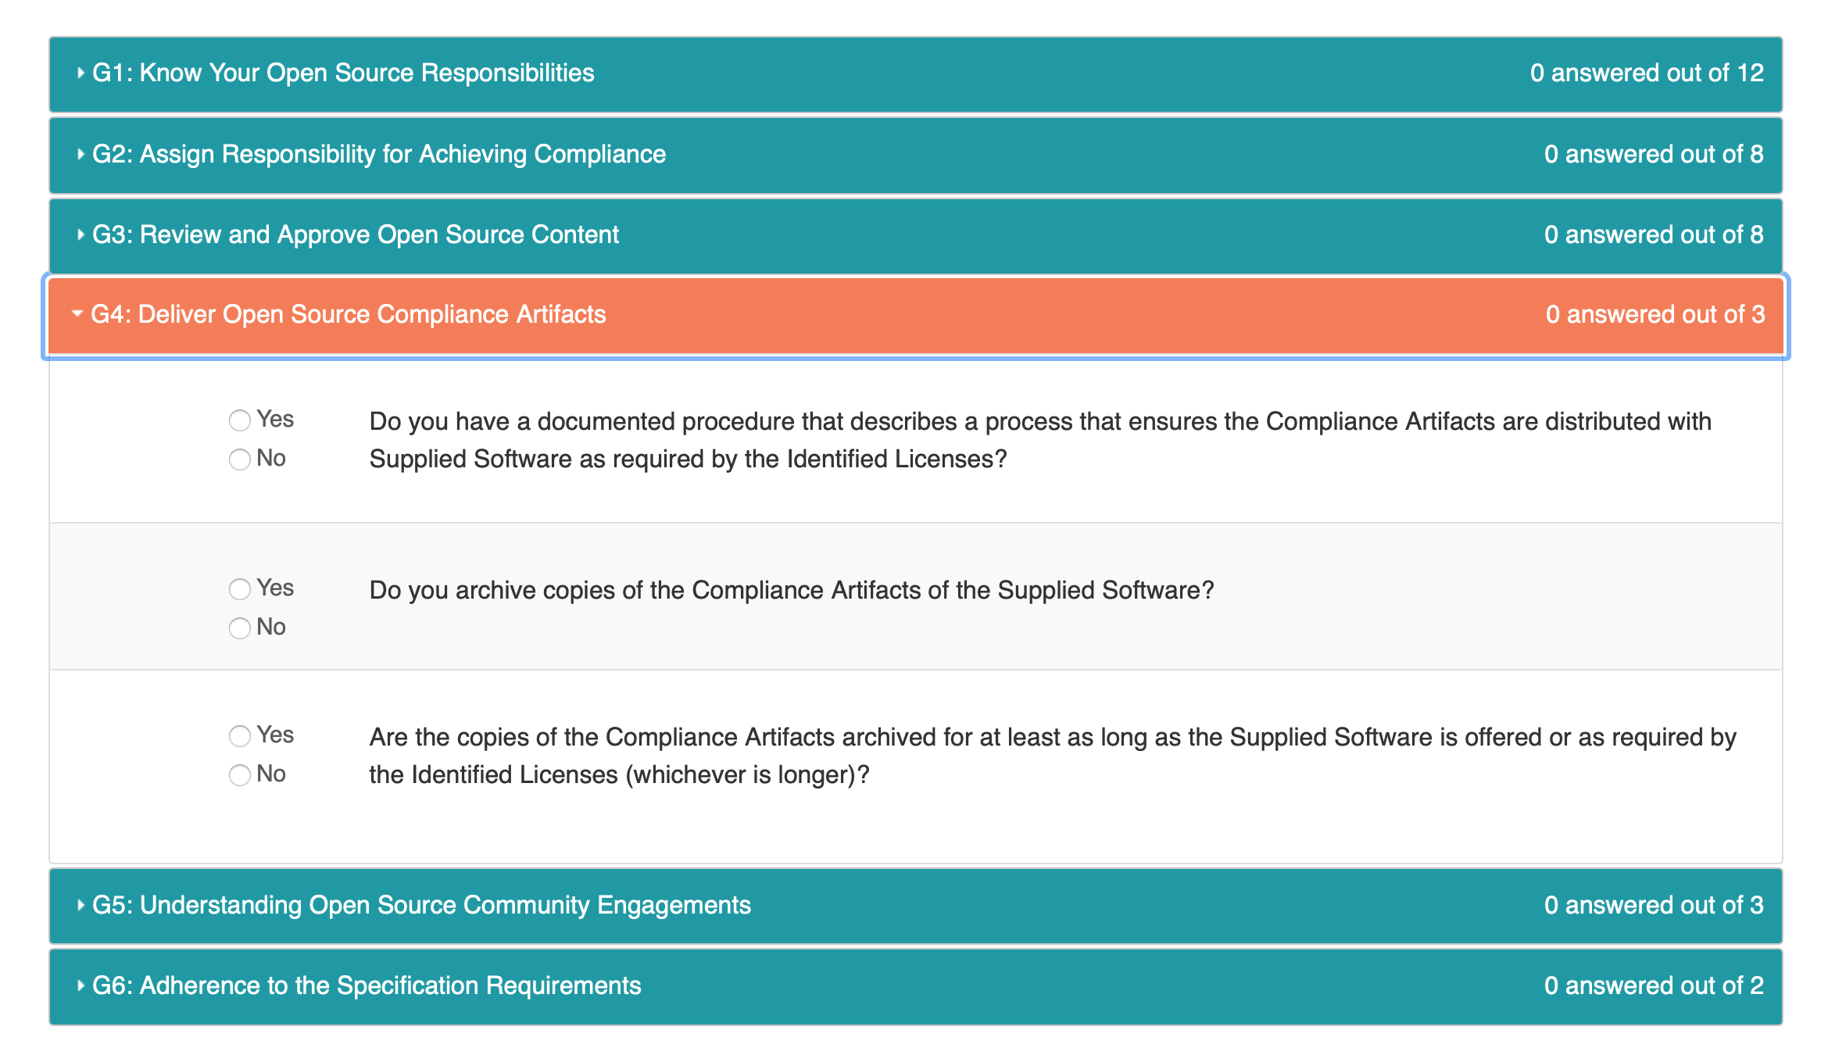
Our Online Self-Certification Questionnaire
Notes:
We have a free self-certification web app with a responsive interface for computers, tablets and mobile phones. It is designed to allow any company in any market to quickly and easily conduct a private “compliance program health check” or to record conformance to the OpenChain Specification.

Slide 11
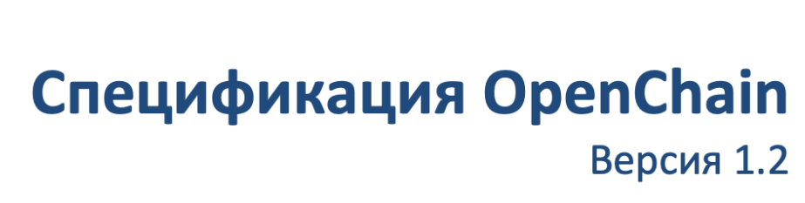
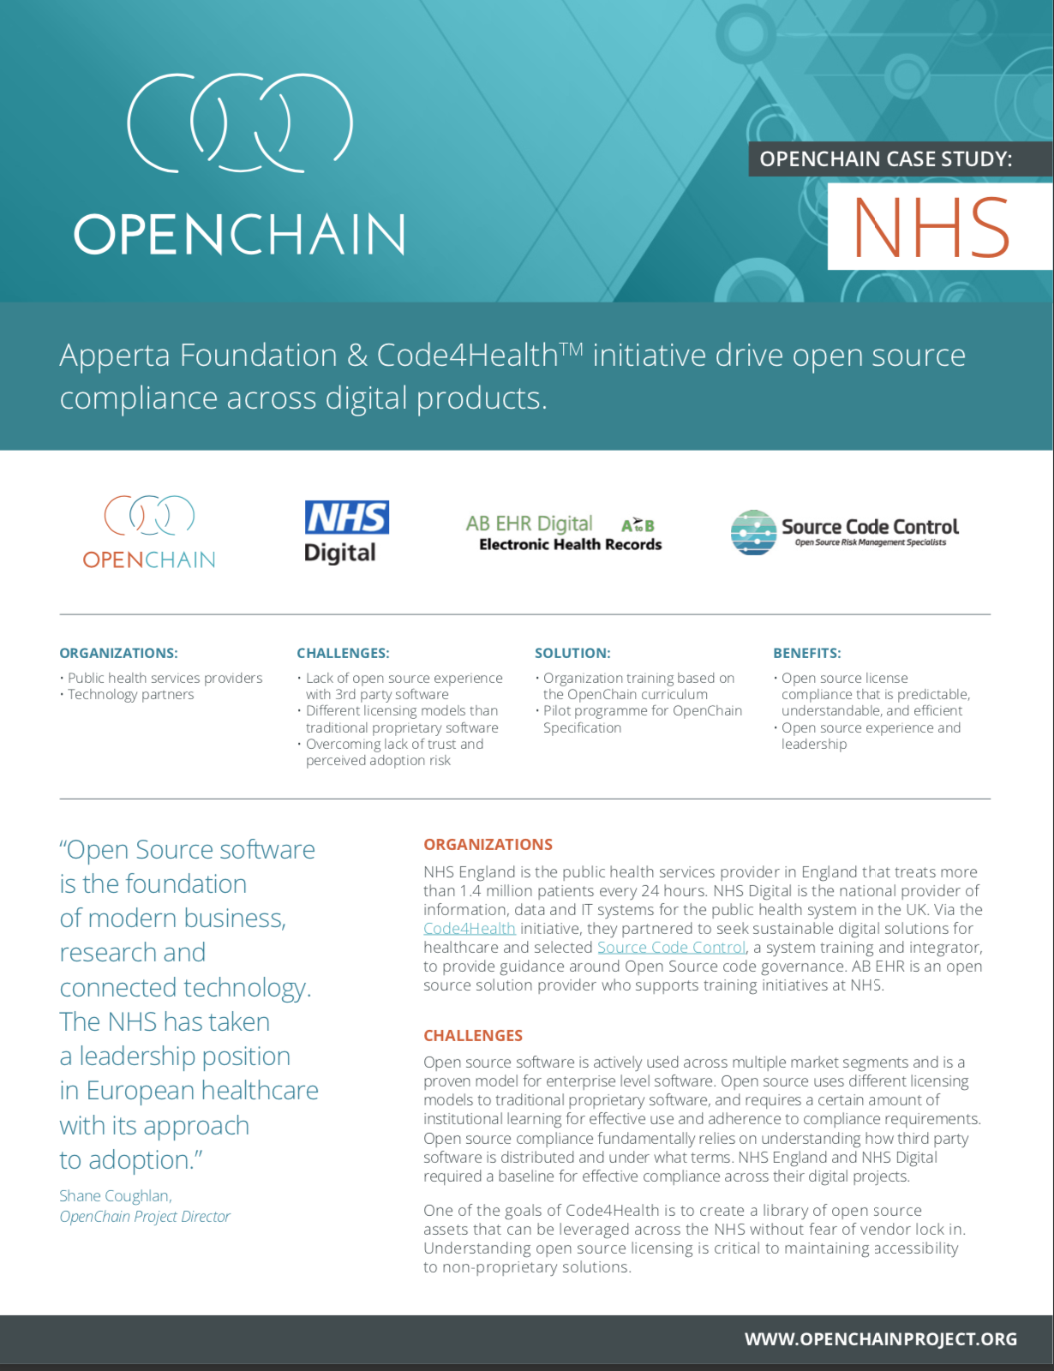
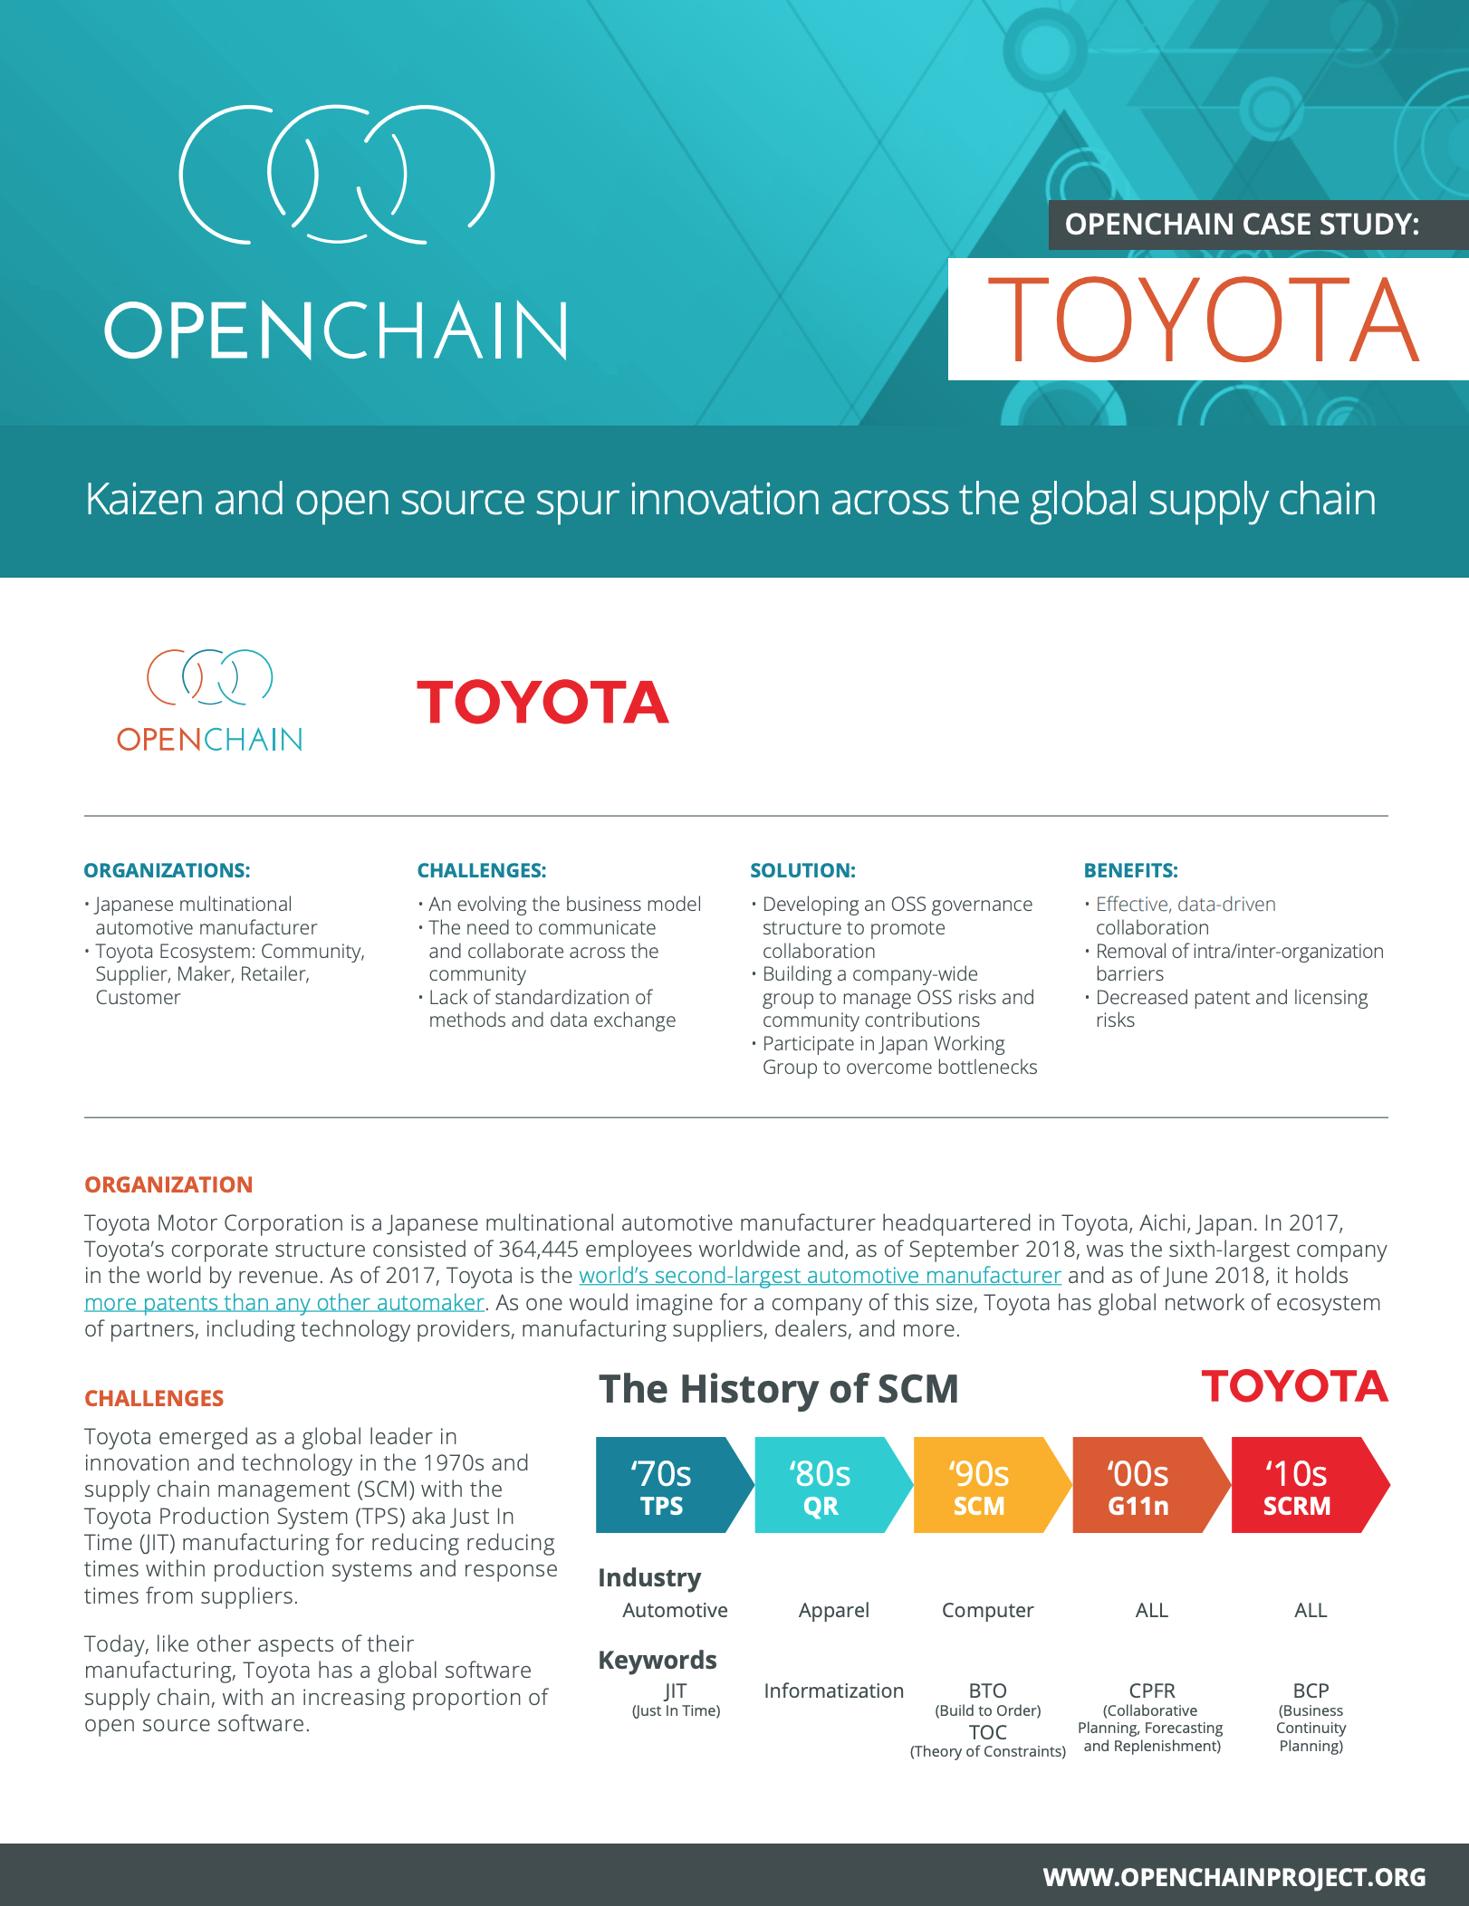
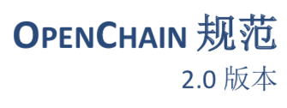
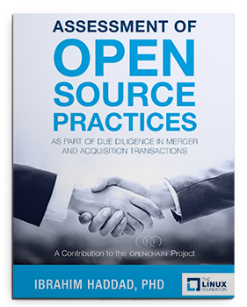

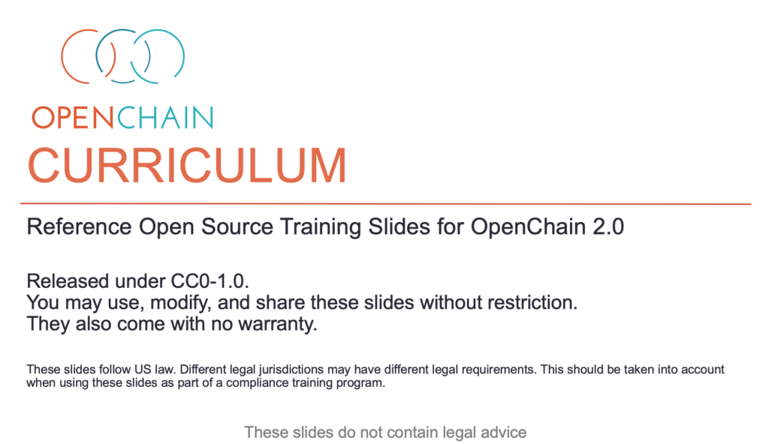
Comprehensive Reference Material
Notes:
We provide a wide range of reference materials and translations to assist with conformance.

Slide 12
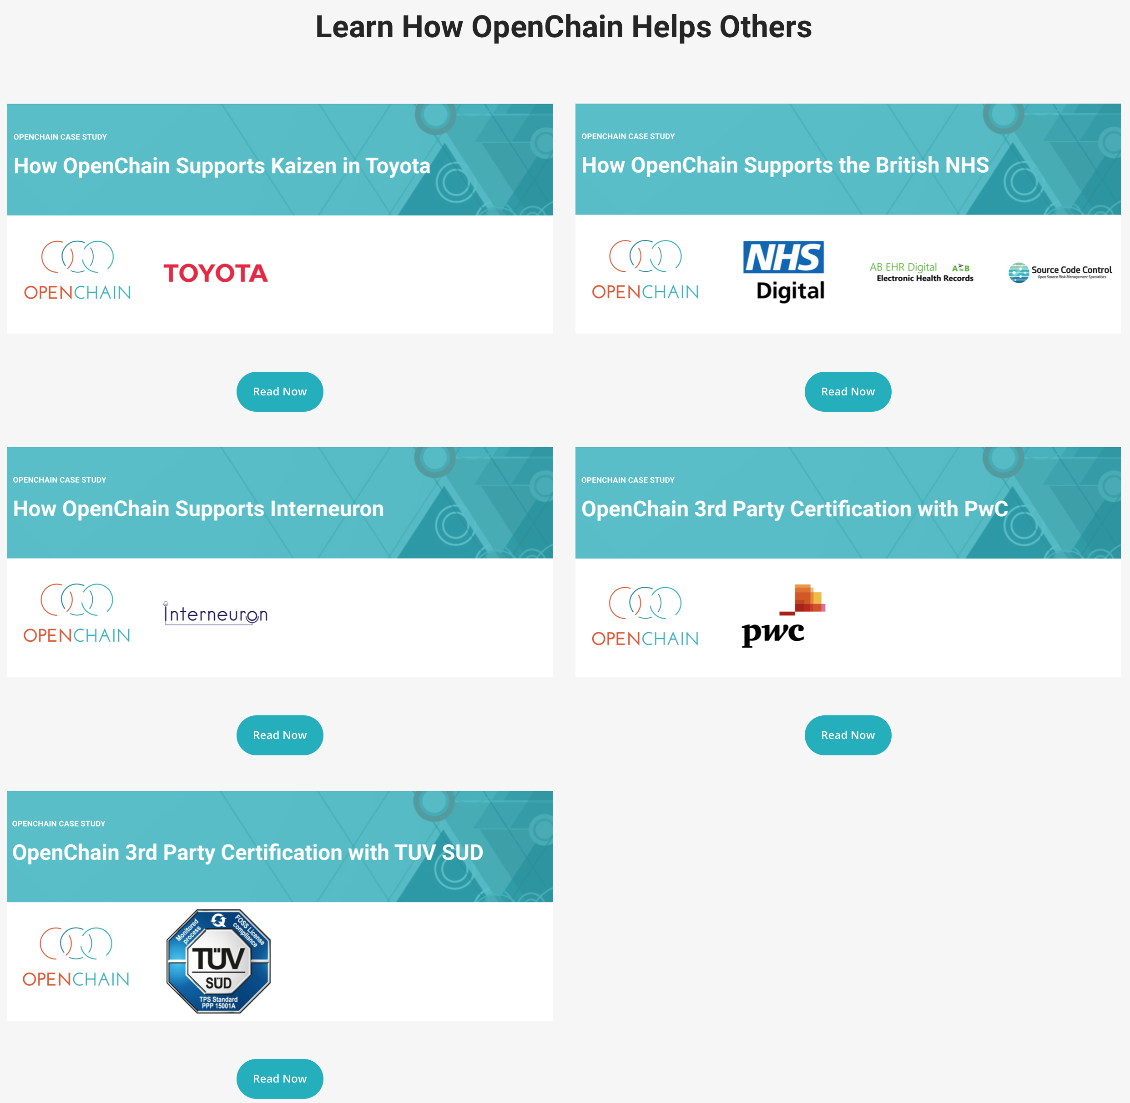
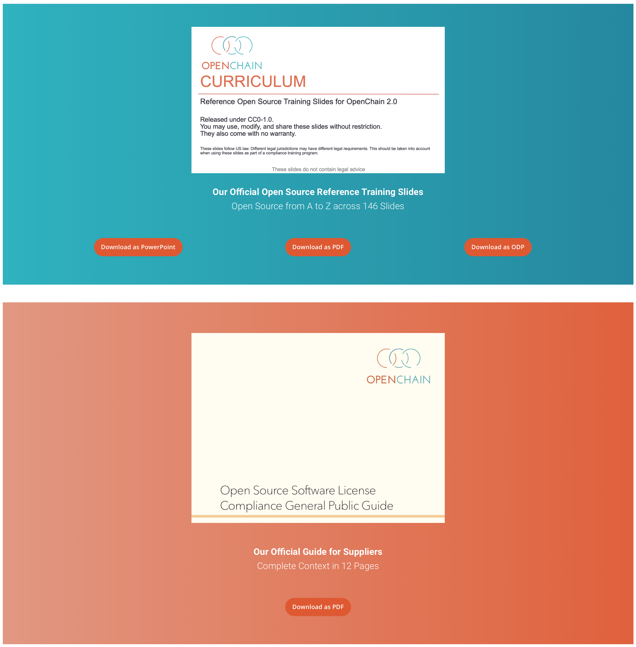
Notes:
The key reference items are provided directly on our website.

Slide 13
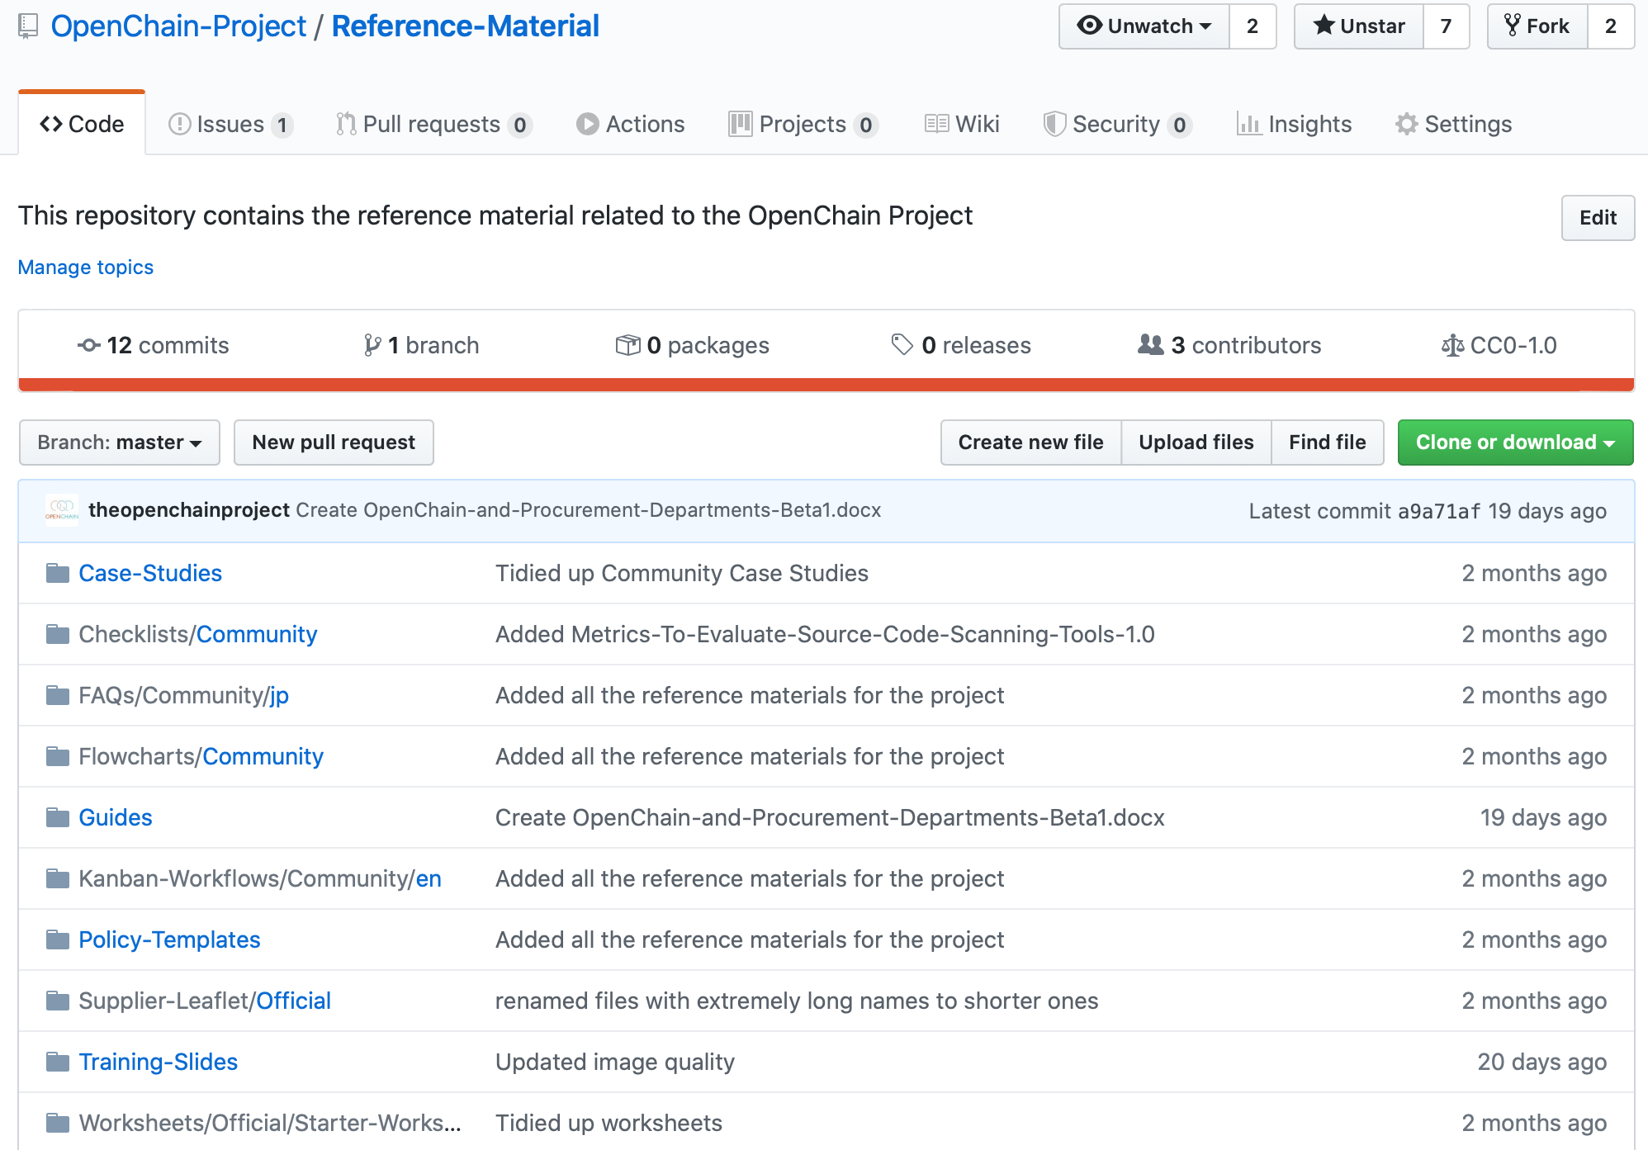
Notes:
A great deal of other information can be found on our Github repositories.

Slide 14
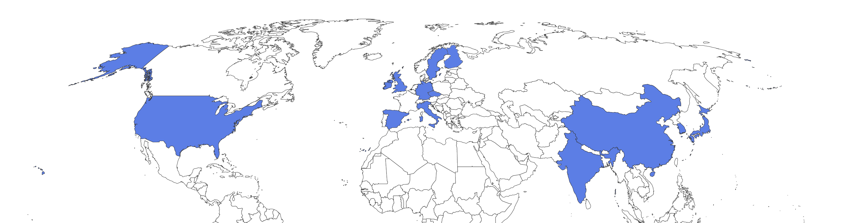
Partner Program
Notes:
We have substantial and growing geographic coverage for the partner program. It now covers a significant number of strategic geographic locations, including the United States, China, South Korea, India, Japan, the UK, Germany, Italy, Spain, Sweden and Ireland.

Slide 15
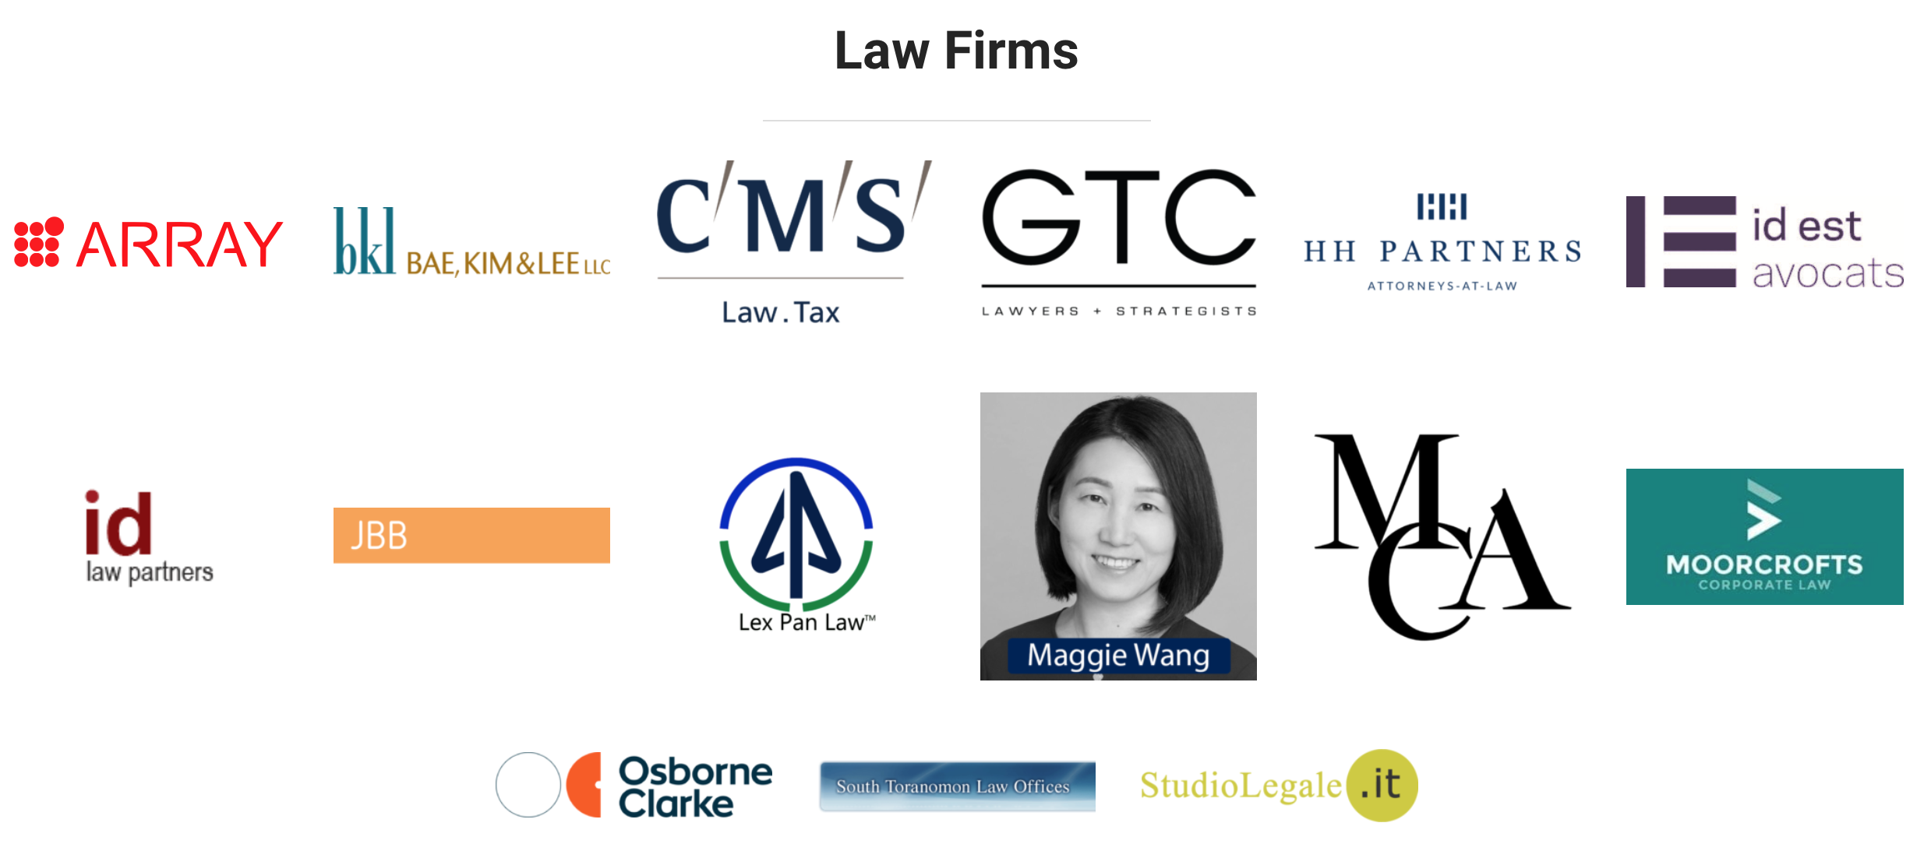
Partner Program
Notes:
We have substantial and growing geographic coverage for the partner program. It now covers a significant number of strategic geographic locations, including the United States, China, South Korea, India, Japan, the UK, Germany, Italy, Spain, Sweden and Ireland.

Slide 16
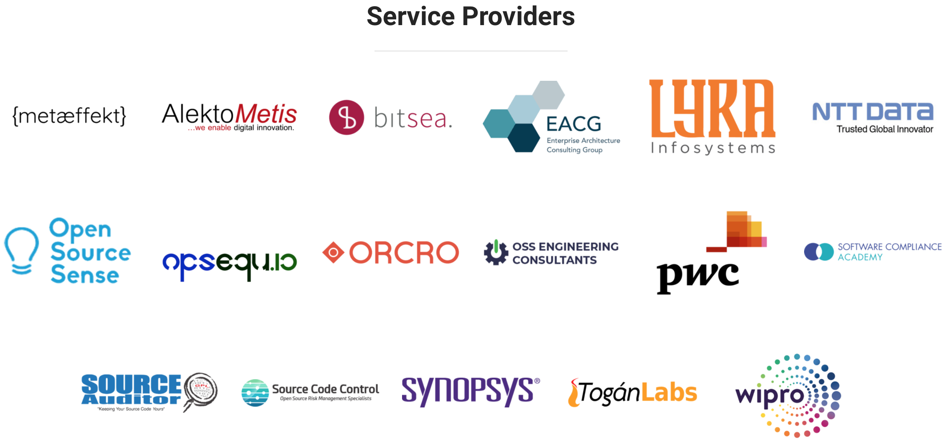
Partner Program
Notes:
We have substantial and growing geographic coverage for the partner program. It now covers a significant number of strategic geographic locations, including the United States, China, South Korea, India, Japan, the UK, Germany, Italy, Spain, Sweden and Ireland.

Slide 17

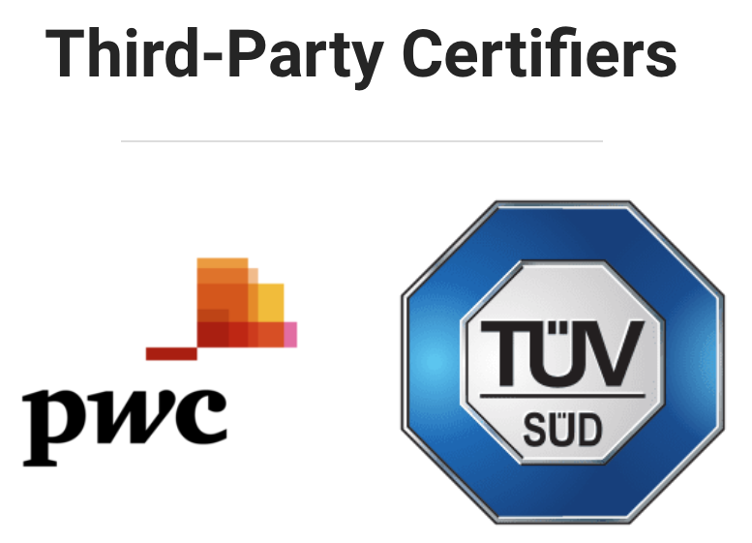
Partner Program
Notes:
We have substantial and growing geographic coverage for the partner program. It now covers a significant number of strategic geographic locations, including the United States, China, South Korea, India, Japan, the UK, Germany, Italy, Spain, Sweden and Ireland.

Slide 18

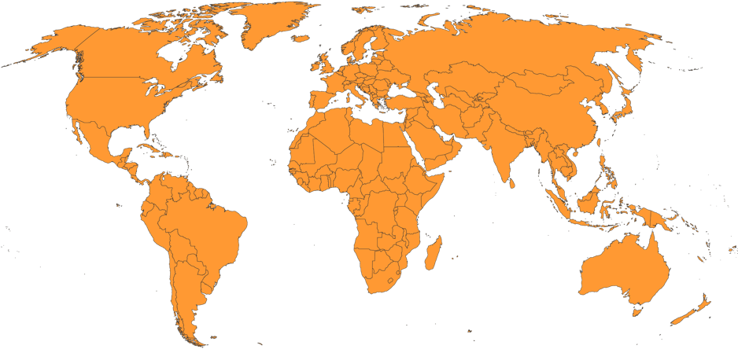
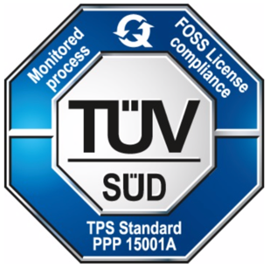
Global Third-Party Certification
Notes:
Our third-party certification offering from TUV SUD is global since March 2019, and is available via the TUV SUD Japan offices. In a similar manner, PwC offer global third party certification / audits since December 2019.

Slide 19
OpenChain in ISO/IEC JTC1
The OpenChain submission is via the ISO/IEC JTC1 PAS transposition process to result in an International Standard. The process usually takes seven to eleven months.
Our ISO/IEC JTC1 submission is in the ISO database. The DIS ballot (DIS 5230) launched on 2020-06-30 and concludes on 2020-09-22. Before this there was an 8 week period for National Standards Bodies to translate the submission. Depending on DIS ballot result and comments received, a further FDIS stage may be skipped. Otherwise, an 8 week FDIS ballot stage is required
The International Standard will be published within 6 weeks or less.

Slide 20
OpenChain in ISO – Formal Standardization
The ISO submission is available at:
https://wiki.linuxfoundation.org/_media/openchain/openchainspec-2.1.draft.pdf
We are working in partnership with Joint Development Foundation to accomplish our transition from de facto to formal international standard.

Slide 21
The OpenChain standard can be met by: Self-Certification Independent Compliance Assessment Third Party Certification
Freedom of Choice for Customers and Suppliers
Notes:
When it comes to meeting the OpenChain industry standard for open source compliance, we are fostering a diverse series of options for our diverse range of stakeholders, from self-certification to independent compliance assessments to third party certification.

Slide 22
Self-Certification is at the heart of the OpenChain industry standard. Companies can access a series of yes/no questions to determine if they have implemented the key requirements of a quality open source compliance program. These questions can be found here: https://certification.openchainproject.org
Self-Certification
Notes:
Self-Certification is at the heart of the OpenChain industry standard. Companies can access a series of yes/no questions to determine if they have implemented the key requirements of a quality open source compliance program. These questions can be found here: https://certification.openchainproject.org

Slide 23
Independent Compliance Assessment works in the same was as the Independent Assessments in other standards. An independent party such as a law firm, consultancy or accounting firm reviews the product of an OpenChain Self-Assessment and offers guidance on whether they perceive it as complete.
Independent Compliance Assessment
Notes:
Independent Compliance Assessment works in the same was as the Independent Security Assessment in ISO26262. An independent party such as a law firm, consultancy or accounting firm reviews the product of an OpenChain Self-Assessment and offers guidance on whether they perceive it as complete.

Slide 24
Third-Party Certification is a process whereby a certification authority guides a company through an OpenChain Conformance Process. The certification authority then issues a formal certification document. This activity maps precisely to the forms of third-party certification observed around automotive, infrastructure and similar fields.
Third-Party Certification
Notes:
Third-Party Certification is a process whereby a certification authority guides a company through an OpenChain Conformance Process. The certification authority then issues a formal certification document. This activity maps precisely to the forms of third-party certification observed around automotive, infrastructure and similar fields.

Slide 25
The OpenChain industry standard has been carefully designed by user companies to identify the inflection points where a process, policy or training should be implemented in an open source compliance program. Our experience shows that self-certification is an effective method of reducing risk and increasing efficiency. That said, the choice of self-certification, independent compliance assessment or third-party certification depends on each business sector and customer base. We seek to provide freedom of choice.
Notes:
The OpenChain industry standard has been carefully designed by user companies to identify the inflection points where a process, policy or training should be implemented in an open source compliance program. Our experience shows that self-certification is an effective method of reducing risk and increasing efficiency. That said, the choice of self-certification, independent compliance assessment or third-party certification depends on each business sector and customer base. We seek to provide freedom of choice.

Slide 26
OpenChain is run by user companies for user companies. This companies are collaborating to create clear, shared and effective approaches to managing open source code.
Notes:
The most important point about how OpenChain is run related to who is running it. The project is run by user companies for user company. Everything we do is service to this and to the shared need for practical, real world solutions to address managing open source code.

Slide 27
OpenChain is well positioned to support and improve supply chain management best practices applicable to vulnerability management. We currently have an active dialogue on how this can be accomplished and all parties are welcome to contribute.
Notes:
The most important point about how OpenChain is run related to who is running it. The project is run by user companies for user company. Everything we do is service to this and to the shared need for practical, real world solutions to address managing open source code.

Slide 28
Be Part of This
Join our community: https://www.openchainproject.org/get-started
Self-Certify or Health Check an organization: https://certification.openchainproject.org
Notes:
You are invited to be part of this. You can join our community by visiting our website, subscribing to a mailing list, or hopping on one of our calls. You can also access the self-certification web-app and check how your current overarching processes map to international norms. Naturally that is completely private until you want to declare OpenChain Conformance.

Slide 29
scoughlan@linuxfoundation.org www.openchainproject.org
Notes:
Please reach out to us if you have any comments, questions or ideas for participation and improvement.

